Slide 1
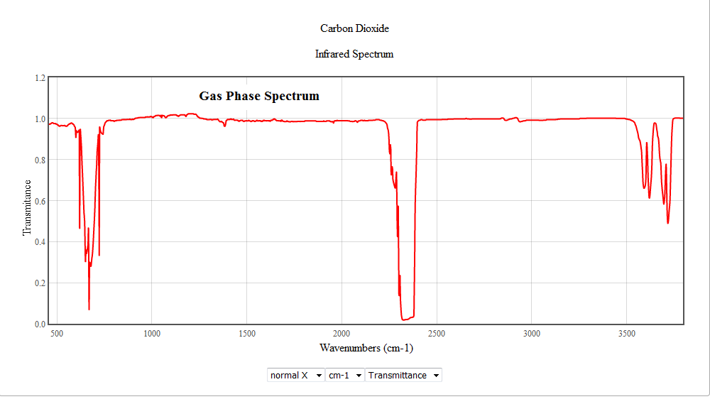
Recap: IR spectra in reality
http://www.geochembio.com/ecology/climate-components/carbon-cycle.html

